Slide 1

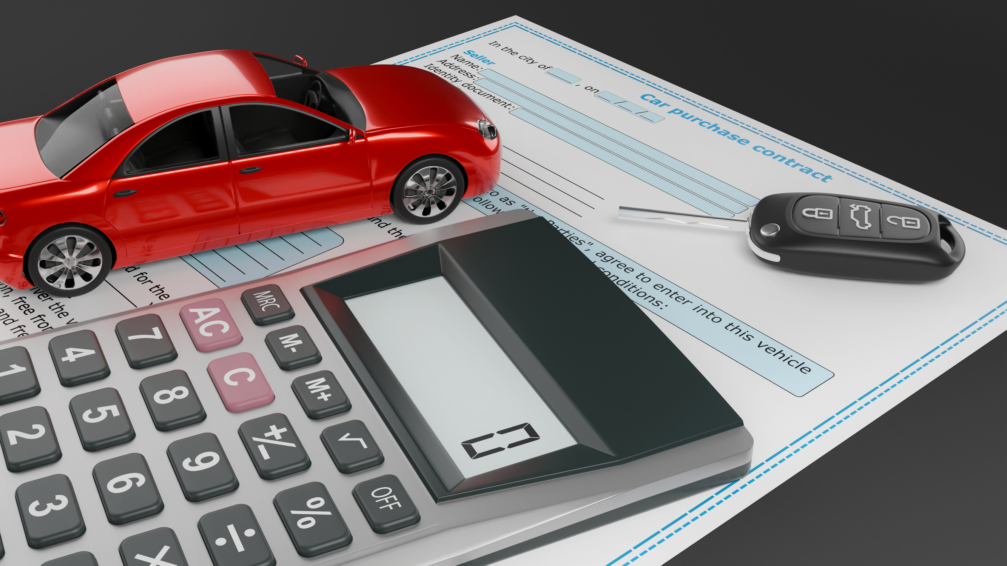


CarPro Insurance Distribution
Insurance Business
Process Overview
Quotation · Policy · Payment · Cancellation
Presentation by Team 2

Slide 2
BIG PICTURE
Customer requests insurance
Agent creates & prices quotation
Customer accepts / rejects / expires
Quotation converted → Policy issued
Cancellation may trigger refund
Policy expires naturally or is cancelled
Policy becomes ACTIVE
Payment created & processed

Slide 3




BUSINESS ACTORS
Customer
Requests insurance, provides info, accepts quotation, pays premium
Insurance Provider
Offers products, pricing logic, policy issuance & lifecycle control
Payment Processor
Processes payments & refunds; returns PENDING / PAID / FAILED / REFUNDED

Slide 4



BUSINESS ACTORS
Agent
Collects info, creates quotation, supports issuance & cancellation
Underwriting Team
Reviews risk, validates eligibility, approves/rejects quotation
Operations Team
Handles failed payments, overdue cases, cancellations & refund follow-up

Slide 5
STATUS MAPPING
Quotation
Policy
Payment
QUOTED
ISSUED
PENDING
ACCEPTED
ACTIVE
PAID
REJECTED
EXPIRED
FAILED
EXPIRED
CANCELLED
REFUNDED
CONVERTED

Slide 6
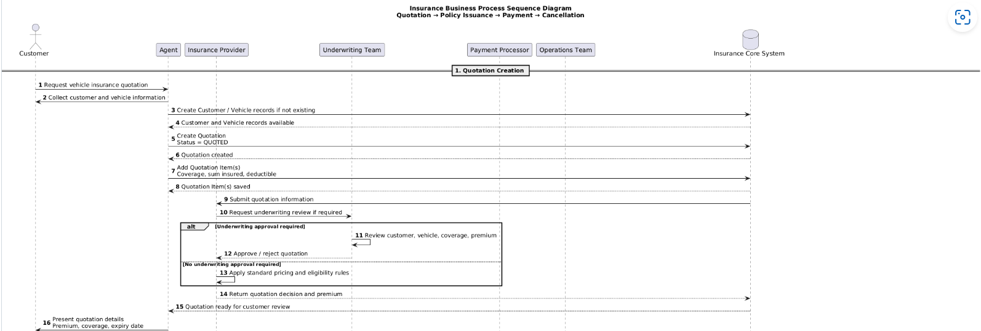
BUSINESS PROCESS
View Full Insurance Process Diagram

Slide 7

BUSINESS RULES
Quotation must exist before policy
Policy created only from accepted/converted quotation
Confirmed Rules
ISSUED ≠ ACTIVE — activation depends on payment & start date
EXPIRED = natural end ≠ CANCELLED = early termination
Payment belongs to policy; starts as PENDING
Cancellation record must include date, reason, refund amount

Slide 8


THANK YOU

